Slide 1
Disaster recover plan (DRP) for code x
By jose flores

Slide 2
Who is involved?
IT Department
C-Suite
Service Provider
Notes:
These are the most important people involved in the DRP development and implementation because of their key roles and knowledge.
The IT Department is primarily the first responder when an incident occurs. Therefore they should be heavily involved when developing and implementing a DRP. They are the subject matter experts on the system's weaknesses and strengths. They are the ones who do risk assessments and audits, thus having the most knowledge of what needs to be brought back first to last.
The C suite is as important as the IT department because they bring leadership experience and authority. They understand the company’s goals and the big picture, therefore, can bring extra support onboard to help assist with the DRP development. They have the power to improve the systems and make changes the IT department cannot do.
The Service Provider is important to involve in developing the DRP because they need to understand the company’s expectations and requirements to ensure different systems are brought up promptly (Moore, 2020). Thus communicating between parties is paramount in case priorities or business goals change.

Slide 3
What is a drp?
Safety Net
Resiliency
Notes:
Disasters can include natural disasters such as tornadoes, hurricanes, and earthquakes. They can include a cyber attack such as a system denial of service or malware. Or they can consist of a human error, such as maintenance breaking a water pipe over the data center or as simple as disconnecting the power source.
If any of those disasters happen, a DRP is a safety net to ensure we can recover from those incidents. Disasters can happen anytime and anywhere. Having a developed DRP will give the company a sign of relief that it has planned for the worse.
DRP also gives the Code X resiliency. It shows that we can adapt and protect our data when a disruption or disaster occurs. We have prepared for planned or unplanned disruptions to regain our system to its full potential.

Slide 4
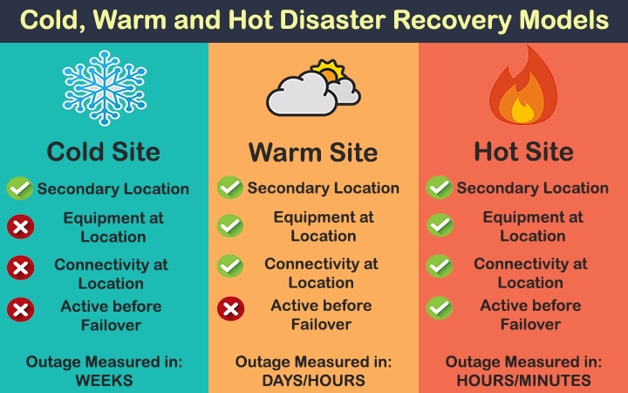
Where would drp be handled?
Disaster Recovery as a Service (DRaaS)
Cold Site
Warm Site
Hot Site
Notes:
A Disaster Recovery as a Service (DRaaS) will handle the Disaster Recover Plan. They are a service provider that will provide a cloud computing environment in case there is a failure in the system (Kirvan, 2020). They offer IT support to help recover and continue the availability of the applications.
Or we can go with a Cold/Warm/Hot Site.
A cold site only includes infrastructure but no technology (Crocetti, 2018)
A warm site is equipped with all or some IT equipment but does not have the data (Crocetti, 2018).
A hot site is fully functional and ready to go in case of a disaster (Crocetti, 2018).
The difference between all three is how fast you want to recover the system and how much the organization is willing to spend.
These sites will be offsite, approximately 50 miles away inland, so a natural disaster does not take out the backup site, but it is close enough to bring the data to it in less than an hour.

Slide 5
when WOULD DRP BE IMPLEMENTED
Natural Disasters
Cyber Attacks
Human Error
Simulated Events
Notes:
Natural Disasters such as tornadoes, hurricanes, and earthquakes. That is why the cold/warm/hot site is 50 miles away from the organization, so the natural disaster doesn’t take both out.
Cyber attacks include multiple approaches but malware and a system denial of service can stop the business instantly.
Human error, such as maintenance breaking a water pipe over the data center or as simple as disconnecting the power source. Situational awareness is critical when doing any maintenance work.
Simulated events are planned events to see how personnel will react. This is critical to do often to see if every person understands their duties and evaluate if the DRaaS is up to par with their responsibilities. Every disaster is different and needs different procedures to maximize recovery. Therefore developing a playbook for each disaster and involving critical personnel specifically for that disaster will be crucial to recovery.
For example, including the maintenance time when the power goes out in the building. If a tornado is coming, include critical roles to ensure equipment is adequately secured, and sensitive documents are either destroyed or taken with a trusted individual.

Slide 6
Why is DRP important
Minimize Interruptions
Limit Damages
Alternative Means of Operations
Notes:
The less interruption the organization has, the faster the business can continue. Every second the system is down will lose revenue the business can develop.
The less damage to the system and data, the less work it will take to recover. The corrupted or damaged applications can slow down business, but the unaffected applications can continue the business.
Alternative means of operation include having the plan to continue the business (Kyndryl, 2022). For example, if the power goes out in the building, being able to continue working on portable laptops is an alternative way. Including generators to continue the operations meanwhile power is restored. If a hurricane is coming, go to the hot/warm site to continue to work until the primary site is restored. Creating the opportunity to work from home in case a pandemic occurs again. Every disaster or incident will have an alternative means of operation when developing a DRP.
Various approaches but the goal is still the same in the end.

Slide 7
How to develop and implement a drp
Audit IT Resources
Critical-Noncrticial
Involvement
Communication
Notes:
Audits
Understanding what a normal operation looks like in the organization is vital to returning to normal after a disaster. Therefore inventorying and tracking the IT equipment is paramount to ensuring systems are back to normal.
Critical- Noncritical
All systems are essential to bringing back, but some are more important than others (Brush, 2022). Some systems are the backbone of the infrastructure and must be brought up first to use other systems. Labeling the system from the most critical to the least is a topic the IT department and C Suite need to discuss and mark together. C suite is involved because they will do a business impact analysis on each system and express their concerns to the IT department. The IT department will be able to explain if the system is vital to bring up first or can wait a bit longer.
Involvement
To know if the DRP is effective and efficient, have feedback from department heads and subject matter experts. They may see something the developers overlook because it is their workspace and responsibility. I
Communication
Communicating if there is a change in policy, equipment, or anything important that can impact the recovery. That means the DRP must be updated to include the new topic and must be adjusted to maximize recovery effort. Whether the DRP is through a service provider or at a cold/war/hot site, communicating the business goals and requirements is a must.

Slide 8
References
Brush, K. (2022). Disaster Recovery Plan (DRP). TechTarget. Retrieved November 13, 2022, from https://www.techtarget.com/searchdisasterrecovery/definition/disaster-recovery-plan
Crocetti, P. (2018). Warm Site. TechTarget. Retrieved November 13, 2022, from https://www.techtarget.com/searchdisasterrecovery/definition/warm-site
Kirvan, P. (2020). 12 steps for a successful DRaaS implementation. TechTarget. Retrieved November 13, 2022, from https://www.techtarget.com/searchdisasterrecovery/answer/DR-as-a- service-What-are-crucial-steps-to-get-started
Kyndryl. (2022). What is a disaster recovery plan? Kyndryl. Retrieved November 13, 2022, from https://www.kyndryl.com/us/en/learn/disaster-recovery-plan
Moore, J. (2020). Disaster Recovery as a Service (DRaaS). TechTarget. Retrieved November 13, 2022, from https://www.techtarget.com/searchdisasterrecovery/definition/disaster-recovery-as- a-service-DRaaS

