Slide 1
TN-Tech
Tactical Network Products
Specialize in Government Compliant Products
CSO: Jose Flores
Email: Jflores1@sandiego.edu

Slide 2
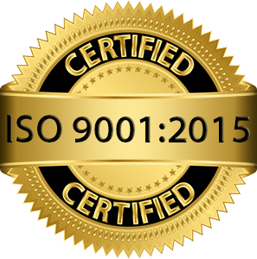
International Organization for Standardization (ISO)
Monitors, Measures, Analyze, and Evaluates Security Techniques
Expand Customer Opportunity (Recognized Internationally)
Consult an ISO Expert
ISO Certified = Stronger Security & More Revenue

Slide 3
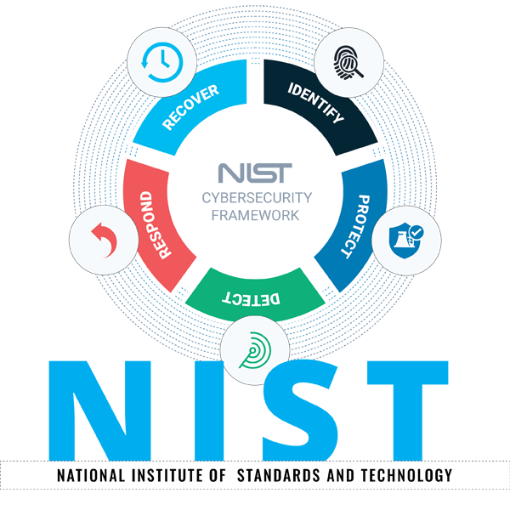
National Institute of Standards & Technology (NIST)
Foundational Protocols
Safeguarding Data Standards
Risk Management Assessment & Corrections
NIST Steps to Compliance

Slide 4
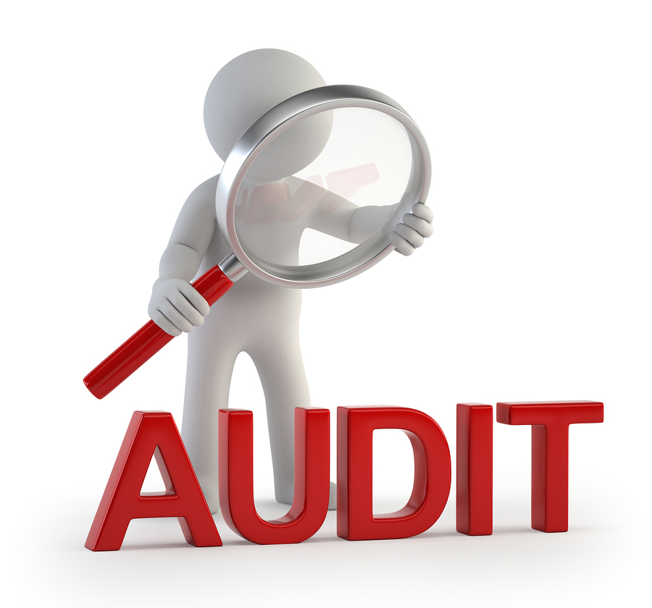
Payment Card Industry –Data Security Standards (PCI-DSS)
Customer Data Security
Encryption Standards for Data
Strict Access Control
Data Minimization

Slide 5
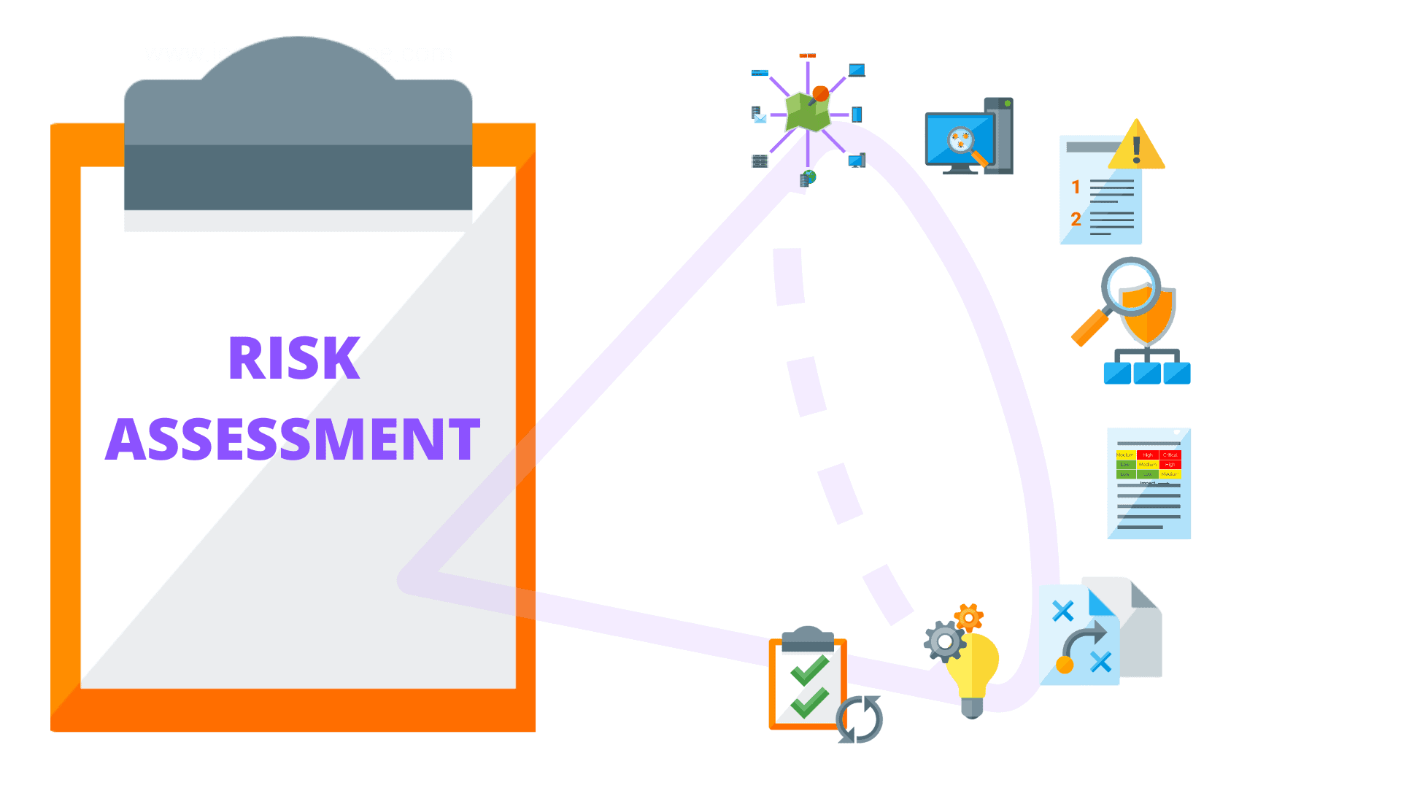
Federal Information Security Management Act (FISMA)
Consistent Security Practices for Products
Evaluation of Policies, Procedures, Practice & Controls
Following NIST Steps to Become Compliant

Slide 6
Cyber Incident Reporting For Critical Infrastructure Act of 2022 (CIRCIA)
Cyber Attacks with Similar Products
Community Involvement Resolutions
Standardized Incident Reporting
Volunteered Reporting until Act Finalized

Slide 7
References
CIS. (n.d.). The 18 CIS controls. CIS. Retrieved October 10, 2022, from https://www.cisecurity.org/controls/cis-controls-list
CISA. (2022). CIRCIA Fact Sheet. Retrieved October 11, 2022, from https://www.cisa.gov/sites/default/files/publications/CIRCIA_07.21.2022_Factsheet_FINAL_508%20c.pdf
CISA. (2022). CISA welcomes input on New Cyber Incident Reporting Requirements. Cybersecurity and Infrastructure Security Agency CISA. Retrieved October 10, 2022, from https://www.cisa.gov/news/2022/09/09/cisa-welcomes-input-new-cyber-incident-reporting-requirements
EC-Council. (2022). U.S. passes New Cybersecurity legislation in June 2022. EC-Council. Retrieved October 10, 2022, from https://www.eccouncil.org/cybersecurity-exchange/career-and-leadership/federal-cybersecurity-laws-june-2022/
Fortinet. (n.d.). What is NIST compliance and how to be compliant? Fortinet. Retrieved October 10, 2022, from https://www.fortinet.com/resources/cyberglossary/nist-compliance
Gillis, A. S. (2020). What is FISMA (Federal Information Security Management Act)? TechTarget. Retrieved October 10, 2022, from https://www.techtarget.com/searchsecurity/definition/Federal-Information-Security-Management-Act
Intelice. (n.d.). Why is NIST compliance so important in Washington DC? Intelice Solutions. Retrieved October 10, 2022, from https://www.intelice.com/nist-compliance-important-washington-dc/
ISO. (n.d.). International Organization for StandardizationI. ISO. Retrieved October 10, 2022, from https://www.iso.org/home.html
Schreider, T. (2020). Cybersecurity Law, standards and regulations. Rothstein Publishing.

