Slide 1
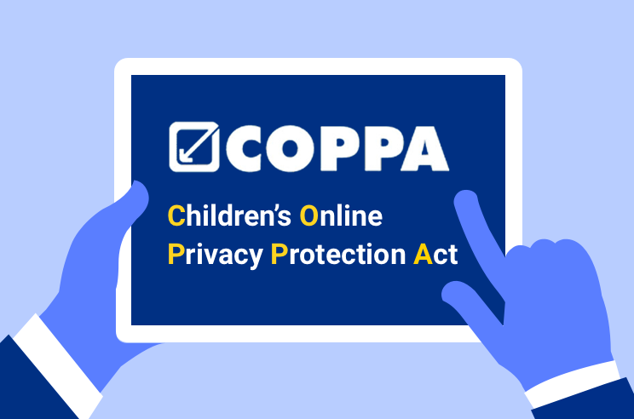
Planning for COPPA Compliance
By: Jose Flores

Slide 2
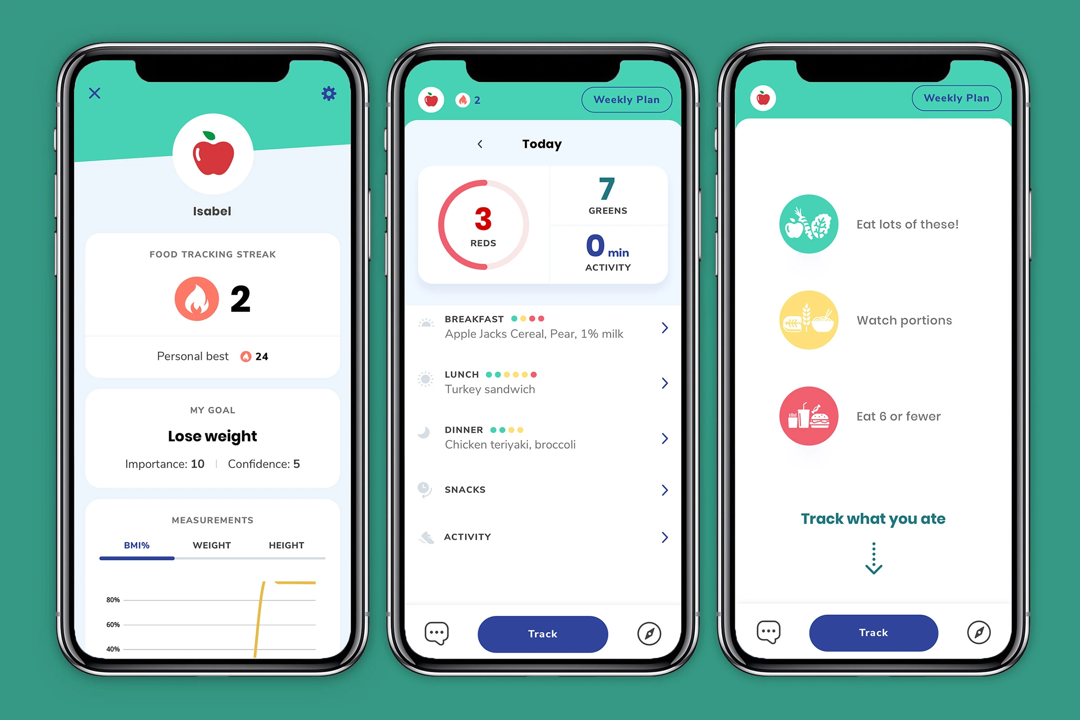
Hyberbeard & Others Penalties
June 2020: Hyberbeard $4 million penalty but will be suspended upon $150,000 payment
Dec 2021: OpenX $2 million penalty
Feb 2022: Weight Watchers $1.5 million penalty
How are they all connected?
Notes:
Hyberbeard allowed third-party advertainment networks to collect personal information and targeted children.
Weight Watchers illegally gathered data through the Kurbo Program (Children Application)
OpenX secretly collected geolocations of children.
All these organizations violated COPPA Law by allowing the third party to use collected information or the organization to gather the information without consent.
All
Source: FTC

Slide 3
Federal Trade Commission (FTC) 6 step Compliance Plan
Step 1: Determining if we will collect children’s personal information
Step 2: Displaying the privacy policy that complies with COPPA
Step 3: Notifying the parents about the company’s information practices before collecting the information
Notes:
Step 1: Why are we collecting Children’s personal information? Do we need it for research or a survey? Is it statistics or monetization?
Step 2: Being transparent with our policies. Let whoever visits the website or application know our policy and make it known. Let the policy hyperlink stand out or be different from other links.
Step 3: Letting them know our intentions will help build a bridge and trust. If we let them know what we plan on doing with the information, then it will avoid any law conflicts. Honesty is the best policy.

Slide 4
Federal Trade Commission (FTC) 6 step Compliance Plan (cont’d)
Step 4: Getting verifiable consent from the parents.
Step 5: Honoring the parent’s right to their child’s personal information.
Step 6: Implementing procedures to safeguard personal information.
Notes:
Step 4: Verifiable consent is important because that is the green light to let us gather information. This can be as easy as a signed, mailed, or electronically scanned consent form. A monetary transaction using a credit card, debit card, or another online payment. Calling in or video conference. Knowledge-based challenge questions
Verifying government-issued ID with database
Step 5: Parents have the right to know how the information is handled and processed. They also have the right to revoke the consent and ask to delete the personal information.
Step 6: Take extra security measures to safeguard the information. What steps will we take to ensure no data leak or misuse of the information?

Slide 5
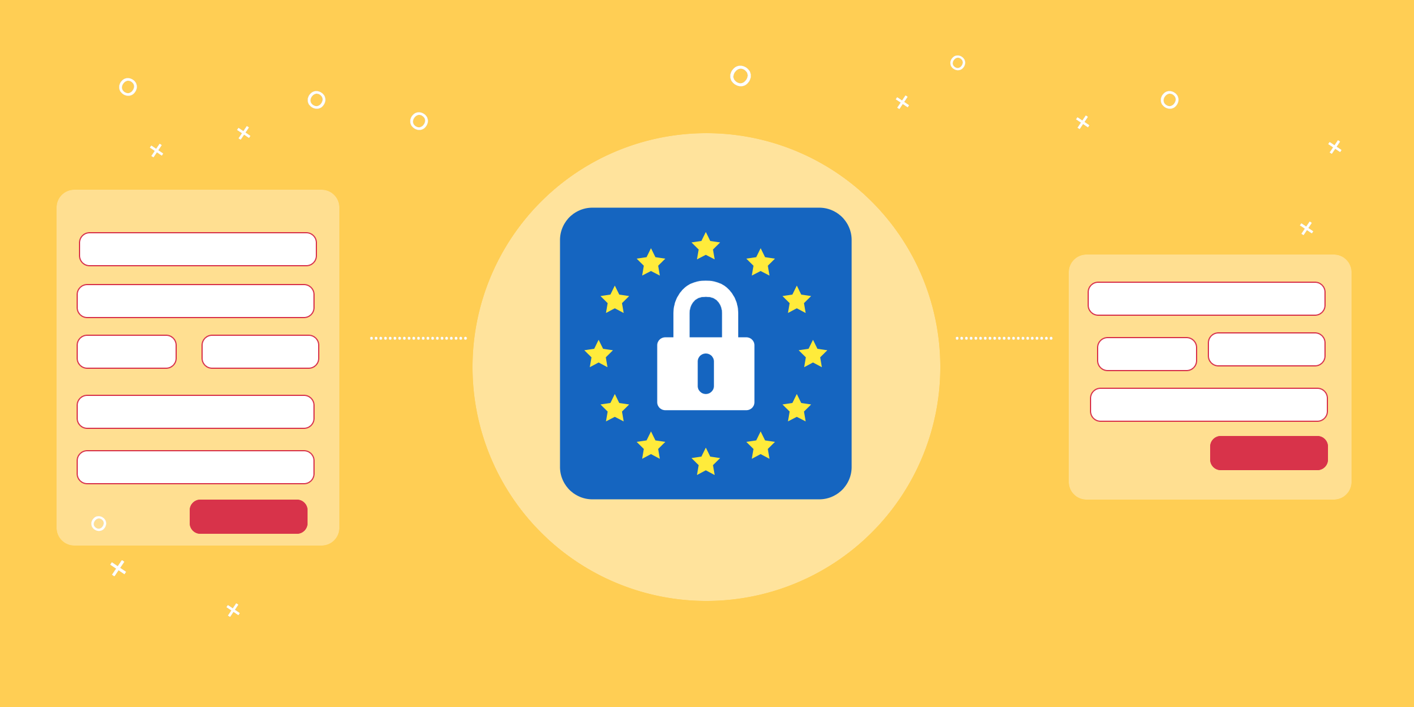
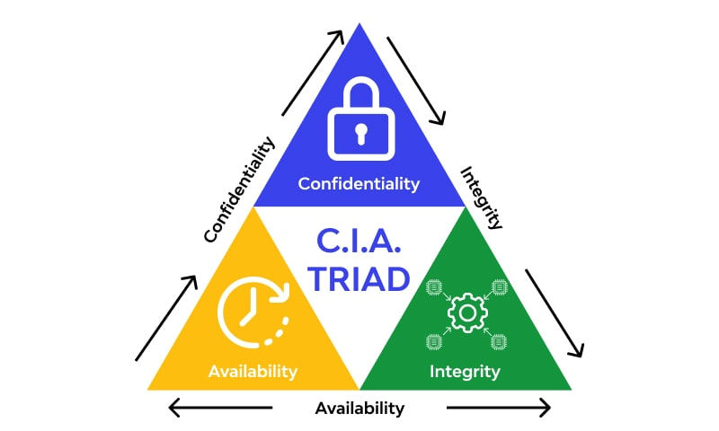
Extra Security Measures
Data Minimization
Scale Down Principle
CIA Fundamentals
Notes:
Data minimization is using the least amount of information needed. We do not need to know the address if the information is only required based on age.
Scale Down principle is collecting and keeping the information that is only required. If the information is not needed, properly dispose of it.
CIA stands for Confidentiality, Integrity, and Availability.

Slide 6
Redefining CIA Triad
Confidentiality
Integrity
Availability
FTC 6 steps + Extra Security Measures = Success
Notes:
Confidentiality We ensure it is kept a secret or private to unauthorized users. This can be done by encrypting the data, multi-factor authentication, and access control policies.
Integrity: Policies and procedures must be adequate to maintain integrity. No one will be held responsible without managerial or administrative control.
Availability: Segmenting the data so no one may access the network. Administrators will be in charge of who has access to the network.
Implementing the 6 steps of FTC and the security measure will help the organization be successful. Additional security measures may be added as technology advances.

